Slide 1
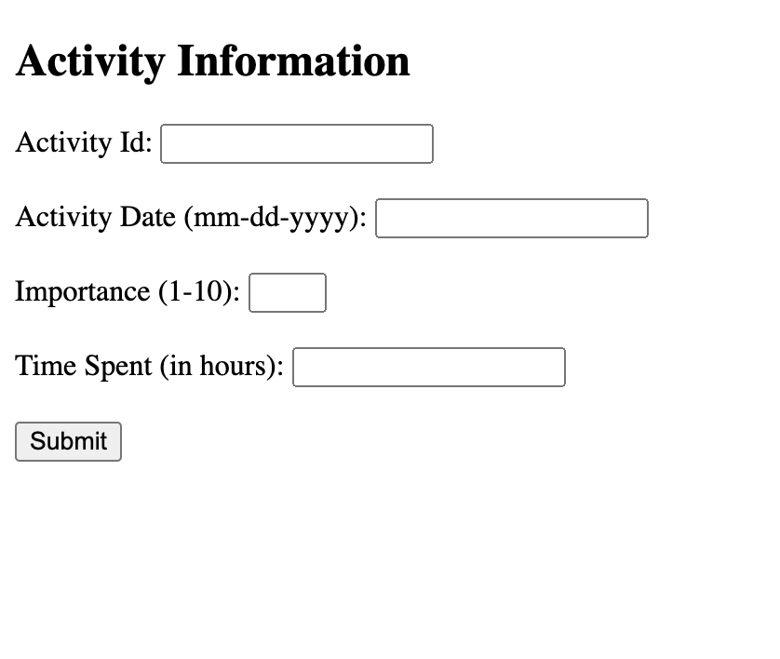
Submitting information
Activity name: _____

Slide 2
Filter
Users can use comparison operators like “LIKE” for strings or ”=, >=, <=, <, >, != for numeric columns and return a table below”
Name:
Date:
Importance:
Time spent:
Productivity
Score:
Id | Name | Date | Importance | Time
Producitivity

